Slide 1
Train the trainers
Setup of a training facility/NSDI Lab

Slide 2
Last time
Delivery
ETL
Services
Access
Applications
DATA
ETL
Database
OGC server
Proxy
GIS
Grafana
Pingdom
Monitoring

Slide 3
Now
Delivery
ETL
Services
Applications
Data
ETL
Database
OGC server
GIS
GDAL
Geopackage
PostGIS
Filesystem
WMS & WFS
Mapserver
Geoserver
Capabilities
Metadata
Styling
Performance
INSPIRE
Features & Layers

Slide 4
Make OGC service
Create dataset
Import data into database
Configuration OGC server
Styling
Metadata/Capabilities
Publish
(monitoring)

Slide 5
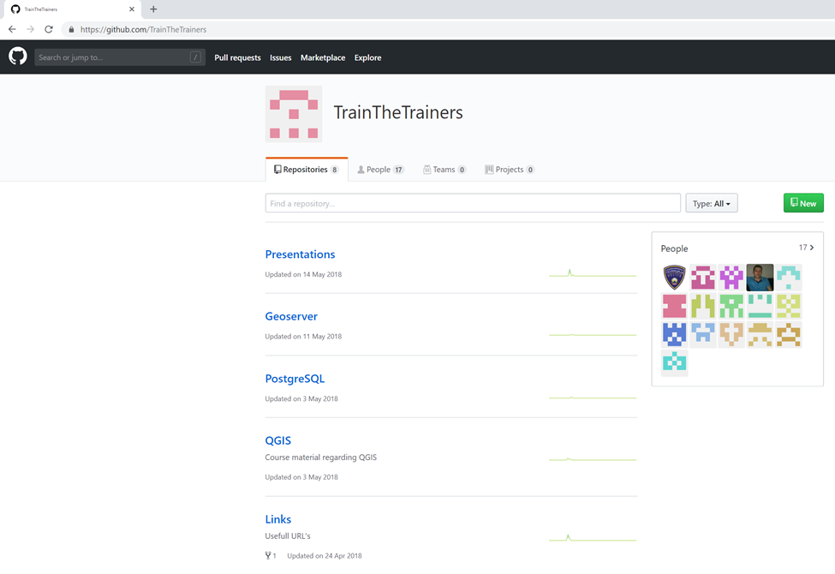
Document the how-to

Slide 6
Retrospective
What do we need to keep doing
What should we stop doing
What do we want to do tomorrow

